Slide 1
Mid Session Project
Data Analytics Certification

Slide 2
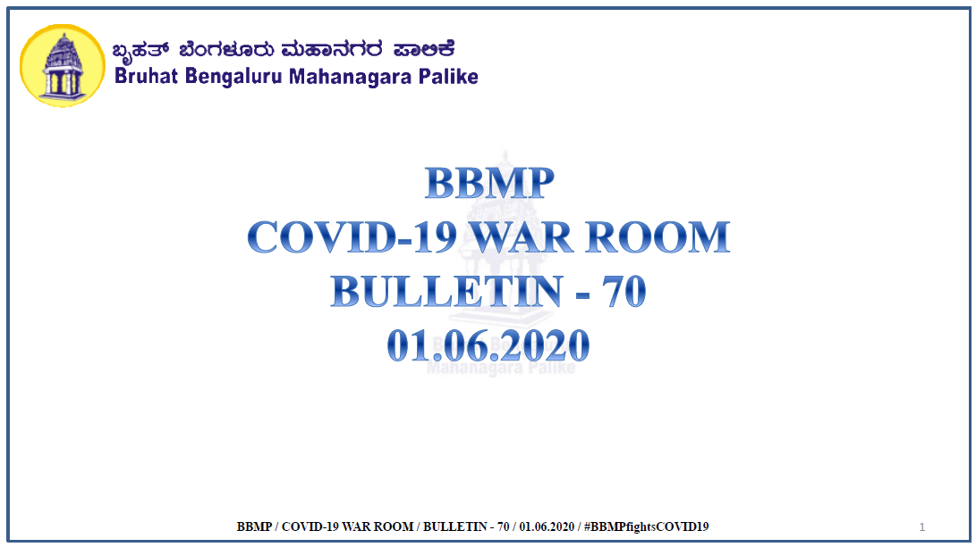
COVID-19 Analysis
Provide data insights into the spread of COVID-19 by using the data provided by the BBMP in Bangalore.

Slide 3
Site for Data
Visual Analysis Dashboard
https://analysis.bbmpgov.in/#/dashboards/7WGKgnEBHZrt-aeeDTHg?embedd=1&toolbar=0&t=bbmp.com
COVID-19 Bulletins
http://bbmp.gov.in/covid-19
Analysis on
Status Of Active Containment Zones In BBMP

Slide 4
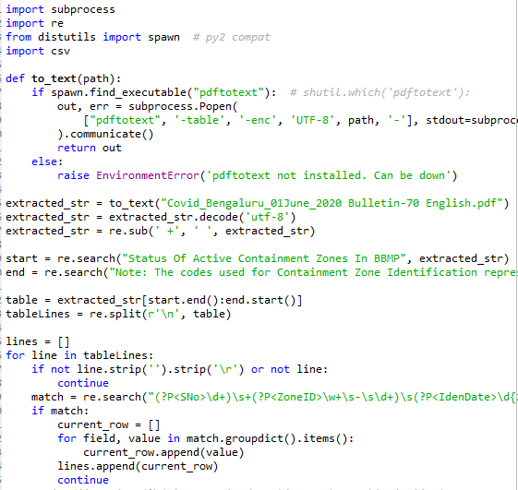
Script Provided
Python Script to extract
Status Of Active Containment Zones In BBMP
to a CSV file for analysis
including the pdf2text converted

Slide 5
THANK YOU sudeep.dsouza@axiscades.com

